Slide 1

Project Communications Management
Notes:
Hi Guys
Welcome to the third in the series of the wonderful world of slidecasts. ☺ I’m your host Sir Olpoc and for this slidecast, our focus would be project communications management. So, without further adieu, let’s begin.

Slide 2

Importance of Good Communications
The greatest threat to many projects is a failure to communicate.
Our culture does not portray IT professionals as being good communicators.
Research shows that IT professionals must be able to communicate effectively to succeed in their positions.
Strong verbal skills are a key factor in career advancement for IT professionals.
Notes:
I don’t think I need to stress the importance of good communications. All of you have experienced this when you were doing your project proposal defense. Most of you I think had the answer, but you were simply unable to communicate it well to the panel. Given the short amount of time you were given, it was necessary to be able to communicate what the project was about and why it should be done.
And I think what happened to most of you (not all of you, mind you) during the proposal defense also highlighted what a lot of people thought of IT professionals – that they are poor communicators. Research has proven that in order for IT professionals to go up the corporate ladder and/or gain more sales, they must be able to communicate well.

Slide 3
Dimensions of Communication
Communication can be:
Internal
External
Formal (reports memos, briefing)
Informal (e-mail, ad-hoc discussions)
Vertical (up and down the organization)
Horizontal (peers, same functional level)
Official (Newsletter, annual report)
Unofficial (off the record communication)
Written and oral
Verbal and non-verbal
Notes:
The problem though with communications is that there are a lot of dimensions to it. Commun ication can be internal or external , formal or informal, horizontal (communicating to your boses and to your submordinates) or vertical (communciting with your peers). It can be official or unofficial (i.e. new or showbiz balita!), written or oral, verbal or non verbal.
There is a host of websites, books, jourmals and magazines about this different types of communication – heck one of the courses that DISCS offered a few years ago was technical writing! And the Eng;lish department is experimenting on business communication – which includes writing formal letters! Hmm… meron kayang love letter writing (baka nga eh love letter twitting na lang siguro ang uso ngayon!).

Slide 4
Project Communications Management Processes
Communications planning: Determining the information and communications needs of the stakeholders.
Information distribution: Making needed information available to project stakeholders in a timely manner.
Performance reporting: Collecting and disseminating performance information, including status reports, progress measurement, and forecasting.
Managing stakeholders: Managing communications to satisfy the needs and expectations of project stakeholders and to resolve issues.
Notes:
Let’s take the perspective of project management. There are four processes involved in project communications : communications planning….yadah..yadah..yadah….
The succeeding slides details each one of these processes.

Slide 5
Communications Planning
Every project should include some type of communications management plan, a document that guides project communications.
Creating a stakeholder analysis for project communications also aids in communications planning.
Notes:
Now, every project should have some form of documentation with regards to how to communicate with the people involved in the project – in other words, the stakeholders. We need to know what to communicate, to whom, and when and how to communicate this information.

Slide 6
Communications Management Plan Contents
Stakeholder communications requirements.
Information to be communicated, including format, content, and level of detail.
The people who will receive the information and who will produce it.
Suggested methods or technologies for conveying the information.
Notes:
So, the communications plan should contain the following information….

Slide 7
Communications Management Plan Contents (cont’d)
Frequency of communication.
Escalation procedures for resolving issues.
Revision procedures for updating the communications management plan.
A glossary of common terminology.
Notes:
(Continue reading)

Slide 8
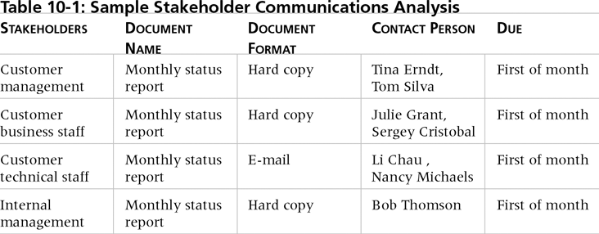
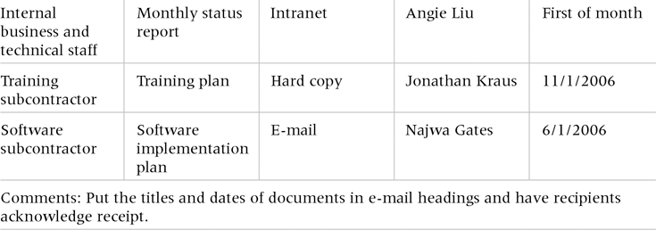
Sample Communications Management Plan for Identified Stakeholders
Notes:
A document that you can fill up to illustrate this communications plan is this communications plan for he identified stakeholders.
Of course, in order to guide you in filling up this form, you may use our discussion on stakeholders – that of their interest, power and influence in the project.

Slide 9
Information Distribution
Getting the right information to the right people at the right time and in a useful format is just as important as developing the information in the first place.
Important considerations include:
Using technology to enhance information distribution.
Formal and informal methods for distributing information.
Notes:
Once we are able to identify what info needs to be communicated, we need to know now how to distribute it. This is where the second process of communcations management comes in – information distribution.
For us, we also need to know what technology to use – kung face to face, email, documentation , twitter or facebook. At your level, siguro pwedeng facebook para sa inyong group updates, pero kung kakausapin ninyo ang stakeholder ninyo, baka ayaw niyang maki-pag-friend sa inyo; so email might be a better means of distributing the information or you might need to set a more formal meeting. This example also show whether a more formal (face to face) method might be more appropriate for some people and for some situations than other people and situations

Slide 10
Distributing Information in an Effective and Timely Manner
Don’t bury crucial information.
Don’t be afraid to report bad information.
Oral communication via meetings and informal talks helps bring important information—good and bad—out into the open.
Notes:
Key things though that need to be kept in mind:
Don’t bury ….. If the info is important …let it be the first thing on your agenda
The same goes for bad information – don’t hide it, let it be basked in all it’s glory! (charing!)
Both formal and informal means of communication should be taken advantage….

Slide 11
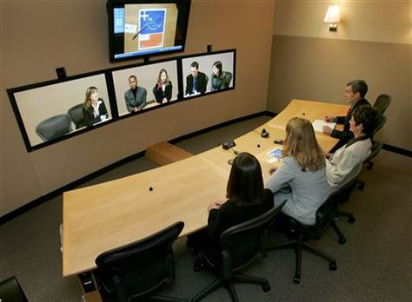
Importance of Face-to-Face Communication
Research says that in a face-to-face interaction:
58 percent of communication is through body language.
35 percent of communication is through how the words are said.
7 percent of communication is through the content or words that are spoken.
Pay attention to more than just the actual words someone is saying.
A person’s tone of voice and body language say a lot about how he or she really feels.
Notes:
Face to face is the most preferred means of communication – especially in projects. If HP truly believed in their virtual teams, there should be no need for them to develop their virtual conference room…
With face to face, you also get to pick up other non-verbal forms of communication that you might not catch on a teleconference or an email – things like tone of voice, facial expressions an body language.

Slide 12
Encouraging More Face-to-Face Interactions
Short, frequent meetings are often very effective in IT projects.
Stand-up meetings force people to focus on what they really need to communicate.
Some companies have policies preventing the use of e-mail between certain hours or even entire days of the week.
Notes:
So, how do we encourage more face to face interactions? Well…

Slide 13
Personal Preferences Affect Communication Needs
Introverts like more private communications, while extroverts like to discuss things in public.
Intuitive people like to understand the big picture, while sensing people need step-by-step details.
Thinkers want to know the logic behind decisions, while feeling people want to know how something affects them personally.
Judging people are driven to meet deadlines while perceiving people need more help in developing and following plans.
Notes:
Remember your MBTI, well, it can also be used for communications management….

Slide 14
Other Communication Considerations
Geographic location and cultural background affect the complexity of project communications.
Different working hours
Language barriers
Different cultural norms
As the number of people involved increases, the complexity of communications increases because there are more communications channels or pathways through which people can communicate.
Number of communications channels = n(n-1)/2 where n is the number of people involved.
Notes:
Other factors that might affect communciation would be the geographic location and cultural background of the people.
When my sister is working from home, she sometimes needs to do a telecon and it does take her sometimes the whole day. Minsan – for most of the conference call, the phone is on mute as she is only there to listen to the conversation and will only unmute it when she is asked a direct question by one of the people in the meeting. Sometimes, she does both the EMIA and NA shift just to have a conference call with her team mates in Europe and North America for the roll out or release of an application. Bawal ang matulog! Good thing she’s a night owl.
Another factor to consider is that as the number of people increases in the project, the more you need to manage it well because you need to communicate the information to at most everyone in the project. They say that the number of communiaction channels that you need to manage is equal to n time (n-1) divided by 2, where n is the number of people involved. This can better be shown through a diagram.,

Slide 15
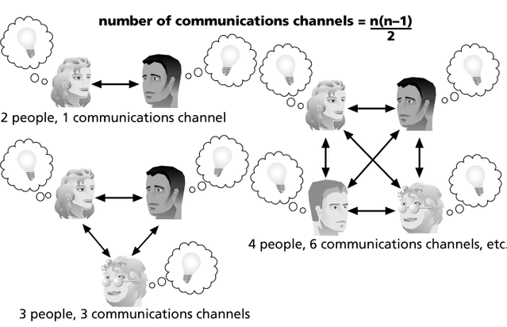
Figure 10-1. The Impact of the Number of People on Communications Channels
Notes:
This slide shows the concept. If there are only 2 people in the project, they only have to talk to each other to get the idea and the thought that needs to be expressed. If there are 3, then the number of communication channels increases to 3; If there are 4, then it goes to six, meaning, at the worst case, the project has to be managed through this six different communication channels.

Slide 16
Performance Reporting
Performance reporting keeps stakeholders informed about how resources are being used to achieve project objectives.
Status reports describe where the project stands at a specific point in time.
Progress reports describe what the project team has accomplished during a certain period of time.
Forecasts predict future project status and progress based on past information and trends.
Notes:
The third process is performance reporting. This basically means how do we inform our stakeholders on the progress of the project – so, this is through our status reports, progress reports and forecasts (like through our PERT CPM – whether we need to crash a project or not; or through our EVMS)

Slide 17
Managing Stakeholders
Project managers must understand and work with various stakeholders.
Need to devise a way to identify and resolve issues.
An important tool : Stakeholder management matrix
Notes:
The last process is managing stakeholders. We’ve basically discussed this concept already, but in the context of communications management, we need to devise a way to identify and resolve various issues raised by a stakeholder.

Slide 18
Identify Stakeholders (Tools)
Stakeholder Analysis:
Identify all potential stakeholders & relevant information : roles, departments, interest, knowledge level, expectations and influence levels)
Identify other stakeholders (done by interviewing identified stakeholders)
Form a grid of stakeholders
Expert Judgment:
Senior management, consultants
Professionals, key stakeholders, project managers having similar experience
Technical associations
Keep
Satisfied
A
B
Manage Closely
H F
Minimum Effort
G
Keep
informed
C
D
E
Notes:
To do this, it’s always a two step process – we identify the stakeholders and their influence on the project and then we create a strategy to manage them. So, we can use the various matrices that we discussed in our stakeholder management topic in order to assist us here. Then….

Slide 19
Stakeholder Management Strategy
Name of Stakeholder | Name of Contact | Stakeholder Type | Influence Level | Interest Level | Support Level | Required Action
NTC | A. Smith | Government | Medium | Medium | Orange | MONITOR (minimal effort)
Ateneo CORD | T. Fernandez | Sector | Low | High | Red | KEEP INFORMED
European Commission | A. N. Other | Contractor | High | Medium | Green | KEEP SATISFIED and BUILD INTEREST
… | … | … | … | … | … | …
Notes:
We can create a stakeholder management strategy chart like this in order to know how to deal with these stakeholders. Again, we used this is something we already discussed in our stakeholder management topic

Slide 20
So in your project…
Need to create a communications plan in narrative form that addresses slides 6 – 7 of this sldiecast.
You can use the chart in slide 8 as a guide, but you can also use a combination of the table in slide 19 and the things needed in slides 6-7
It would also be nice to include a narrative of your stakeholders and their level of interest and power in this section of your paper.
Note that you have to identify your stakeholders (e.g. your project team, your main contact person, the people who will be affected in the project, the people involved in the project, etc.) and discuss what to communicate with them, when do you communicate it, how do you intend to communicate it and how often do you intend to communicate.

